Slide 1
Preventive maintenance for TEOS Machine.
TYPE: SPM or Small PM
Prepared By: Michael,卡莫那
Furnace-Diffusion Department [S220]

Slide 2
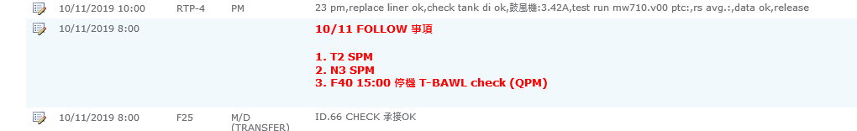
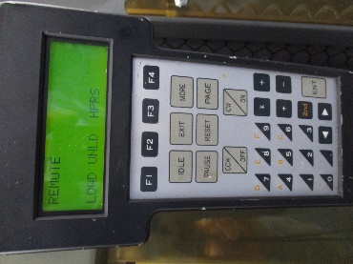
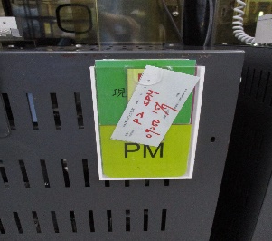
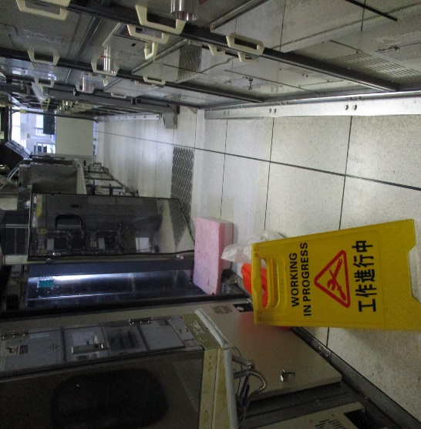
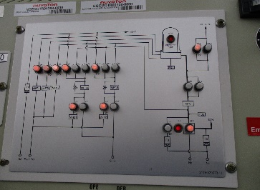
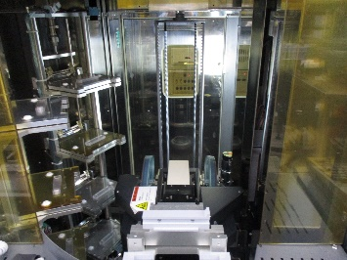
PM Procedure
Step 1. Check in the computer if the machine is scheduled to PM.
Step 3. Get VL800 and go to the back of the machine.
Step 2. Check Machine status.
Step 4. Put sign that you have a work to do before you continue to work.
Machine Label.
ATM Mode Red light ON.
No Cassette and dummy wafer into the boat.

Slide 3
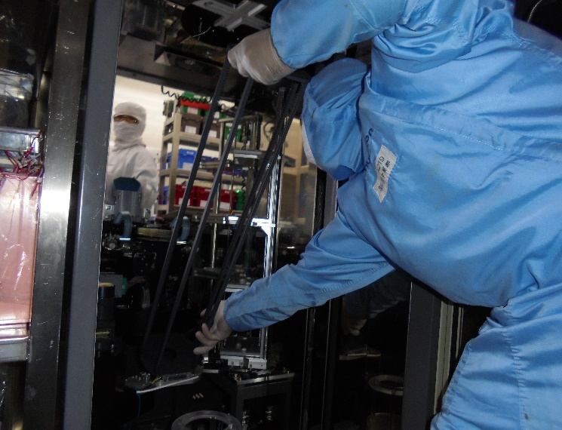
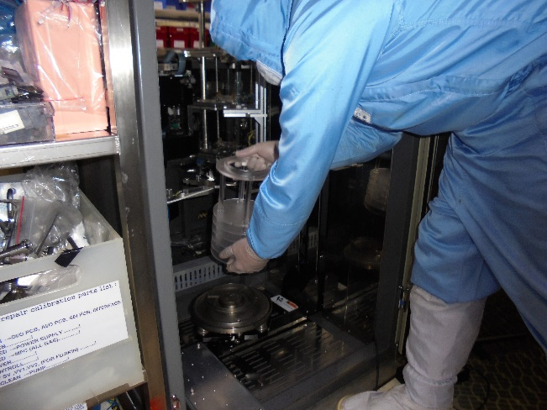
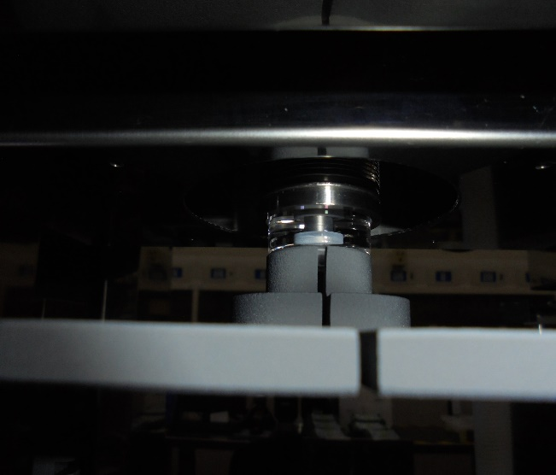
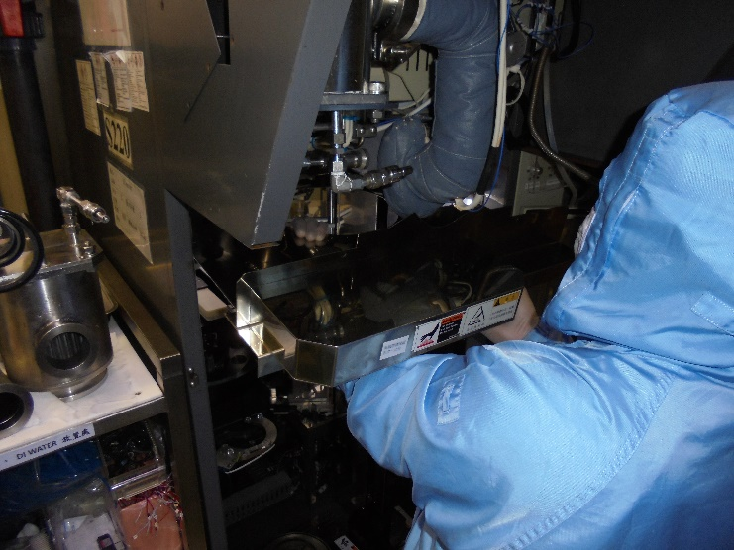
Step 5. Remove the pedestal.
Step 7. Unload the boat carefully by 45 degrees and avoid contact to other parts of the machine.
Step 6. Remove boat. Unlock boat lock using VL800. Go to M05 and press CW/ON . If release unload the boat.
Step 8. Remove Cover.

Slide 4
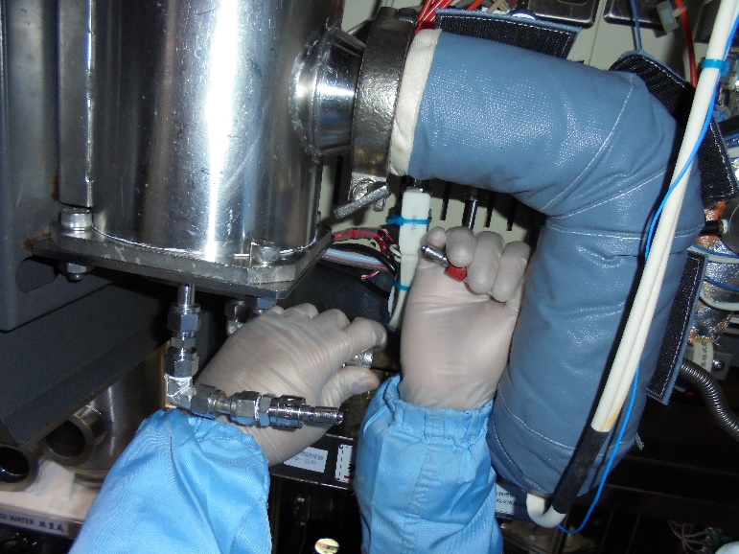
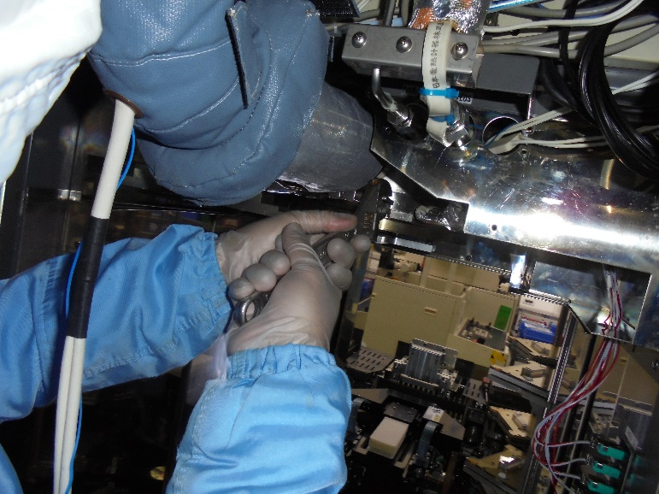
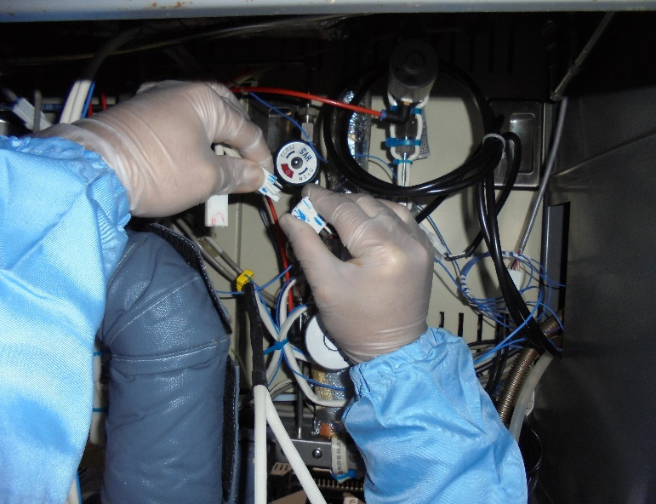
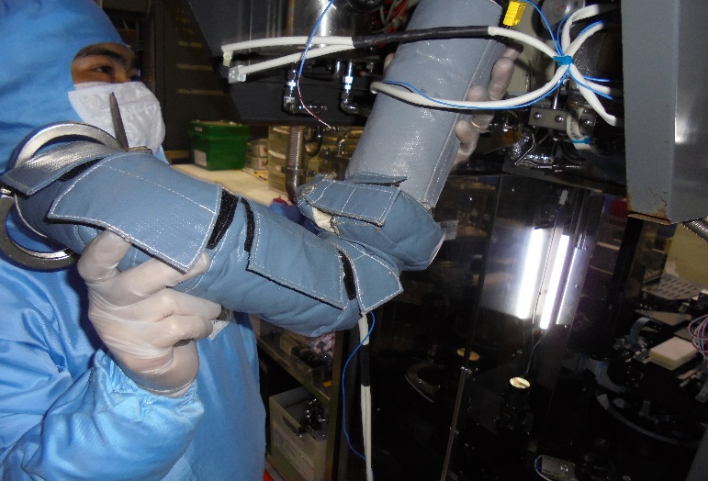
Step 9. Remove cold trap supply.
Step 11. Remove below and pipe clamp.
Step 10. Unplug pipe heater supply.
Step 12. Remove pipe and below.

Slide 5
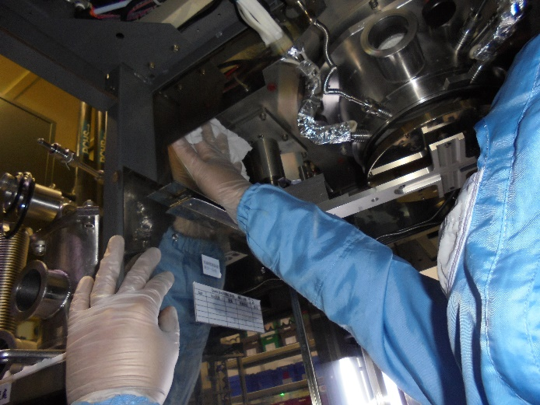
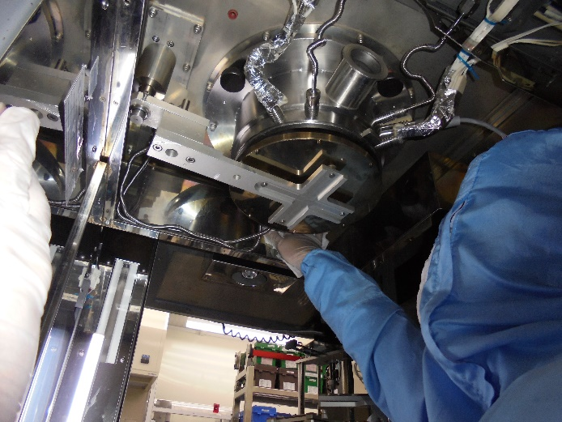
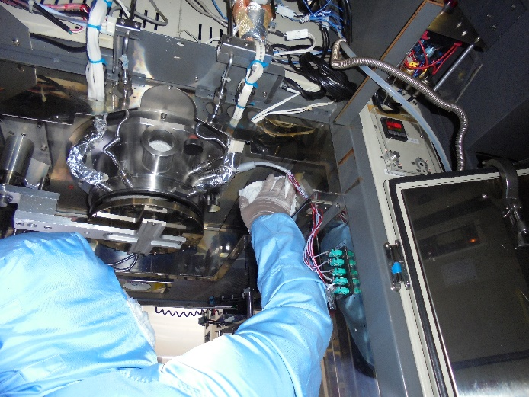
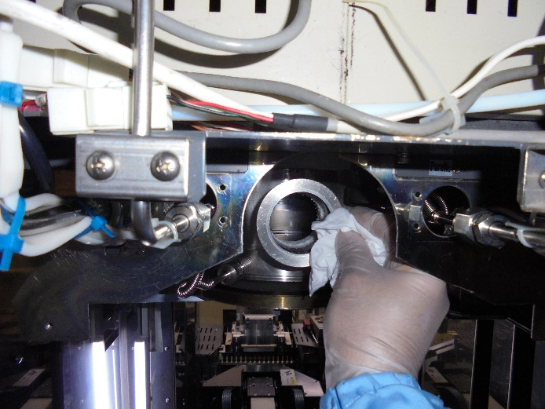
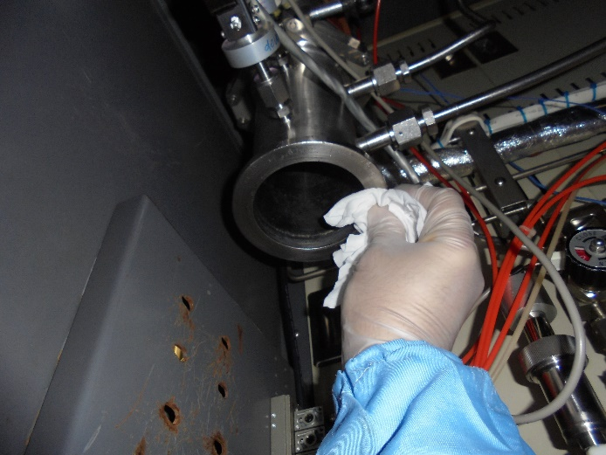
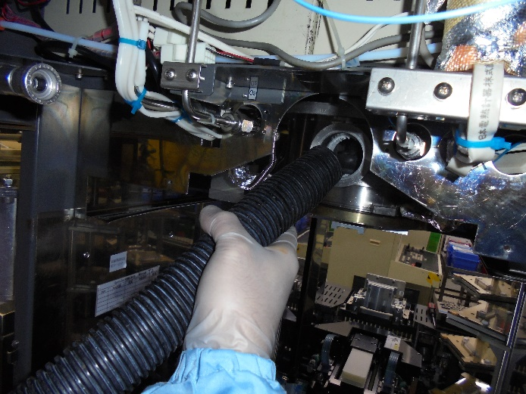
Step 13. Clean wall and connections to new parts.
Shutter Must be open while using the vacuume..

Slide 6
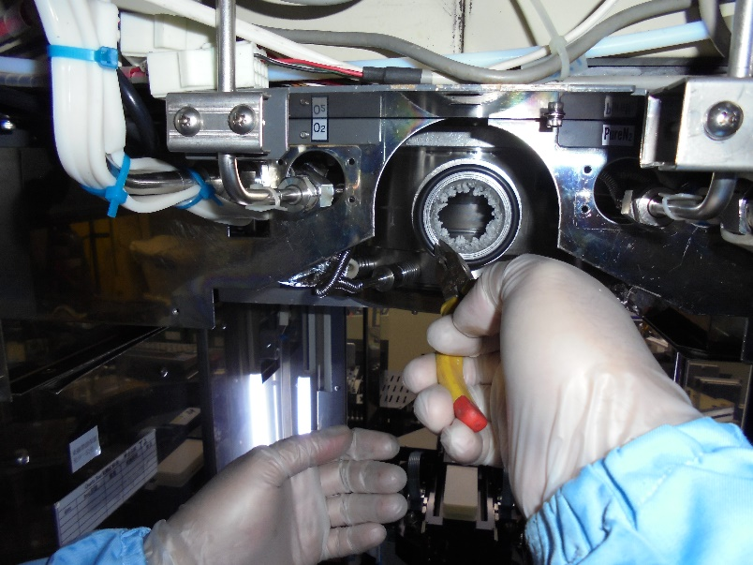
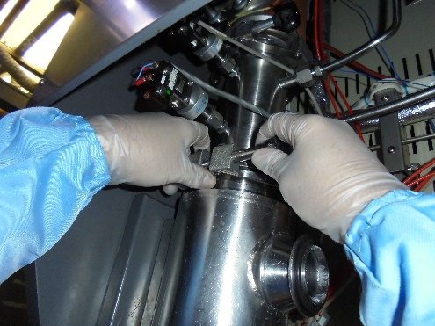
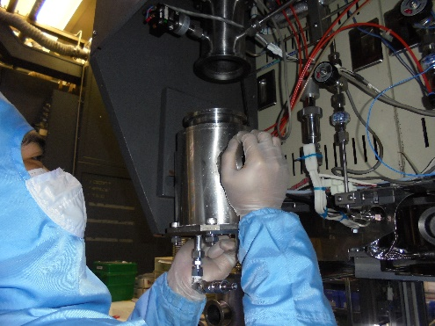
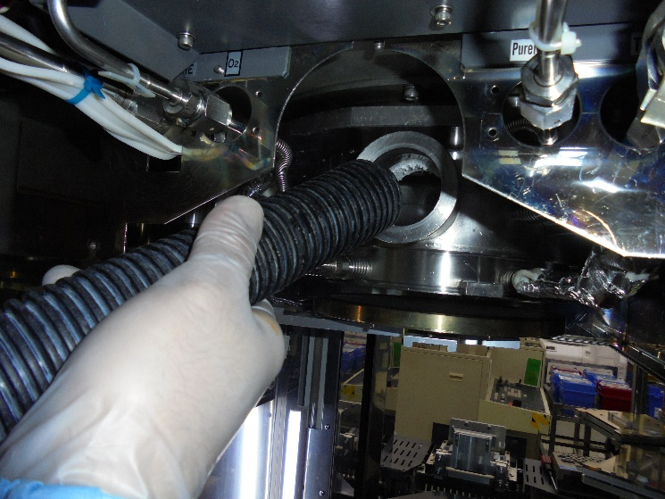

Step 14. Remove O ring. Use tool because it is hot.
Step 16. remove cold trap.
Before you remove the Luck belt make sure that the cold trap is luck by butterfly luck to avoid it fall.
To remove cold trap use right hand to support the weight and if the luck is remove use left hand to support the cold trap.
Step 15. Use vacuum to remove particle while the shutter is open to vacuum the particle.
Step 17. Clean cold trap connection

Slide 7

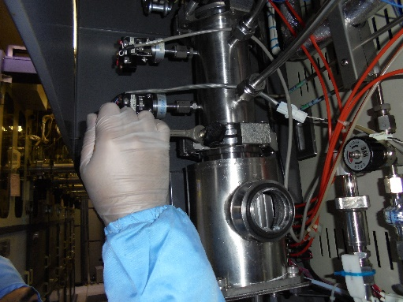

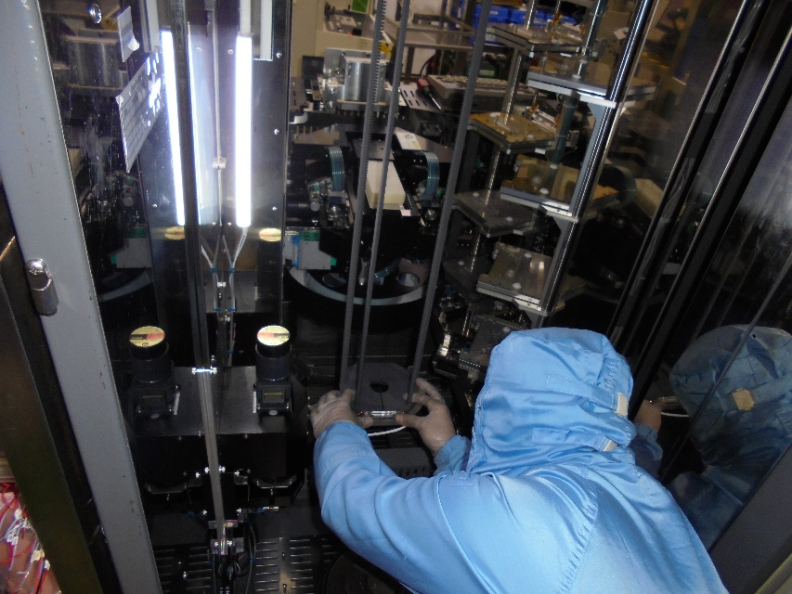
Step 18. Install new cold trap. See cold trap assemble.
Step 20. Install New Boat.
Load the boat in 45 degree angle and avoid the boat to touch any part of the machine to avoid damage off the boat.
Install cold trap and luck the butterfly nut to secure the cold trap to fall.
Install the luck belt to secure the connection of the cold trap to avoid leak.
Step 19. Install Pipe and below.
Step 21. check the gap of the boat and arm sensor to avoid any damage.

Slide 8

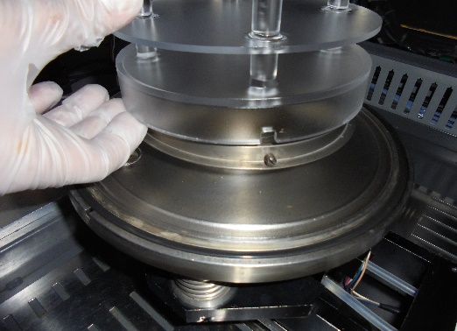
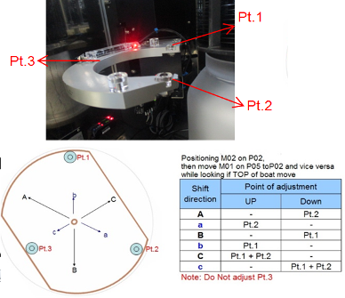
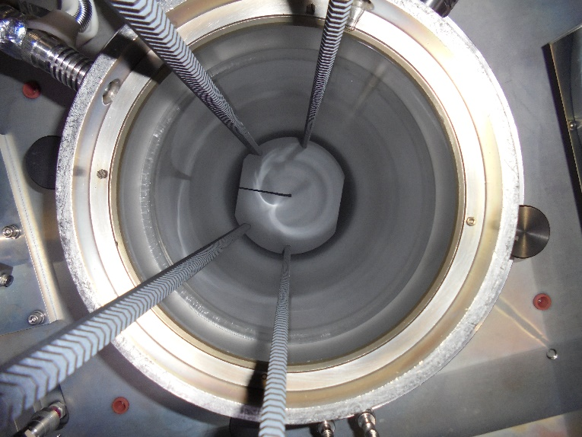
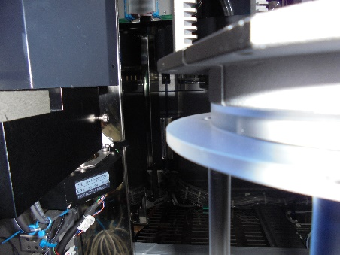
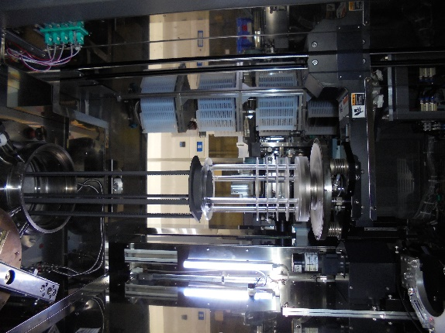
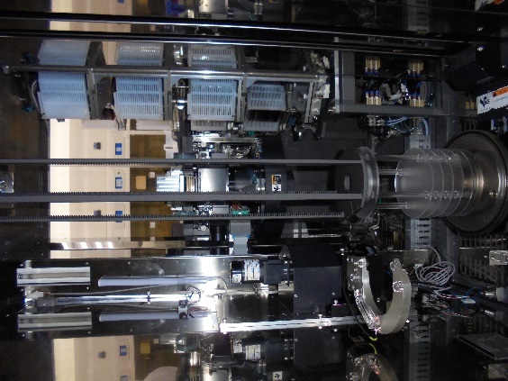
Step 22. Install the new pedestal.
Step 24. Adjust 3 points of the boat arm to avoid vibration and shaking and to avoid NG of the products.
Find the stopper of the pedestal and a line it with the whole.
Step 23. Check alignment of boat and pedestal make sure the gap is balance from pedestal to boat..
Step 25. Check Boat to tube gap. Boat should not touch.
1000
Boat UP Height of 1000.
Rotate M06 and check if the boat do not touch the tube or injectors. Best is to Balance the boat perfectly.

Slide 9

Step 26. Position the boat to P01 to check and adjust the load luck.
Note: Load luck and boat should be Balance.

Slide 10
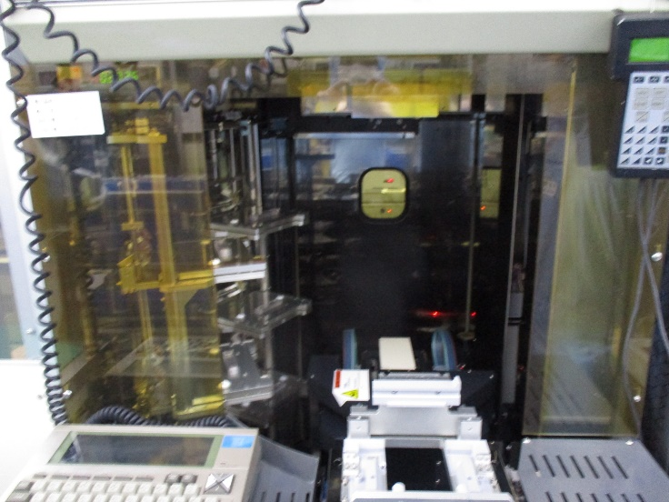
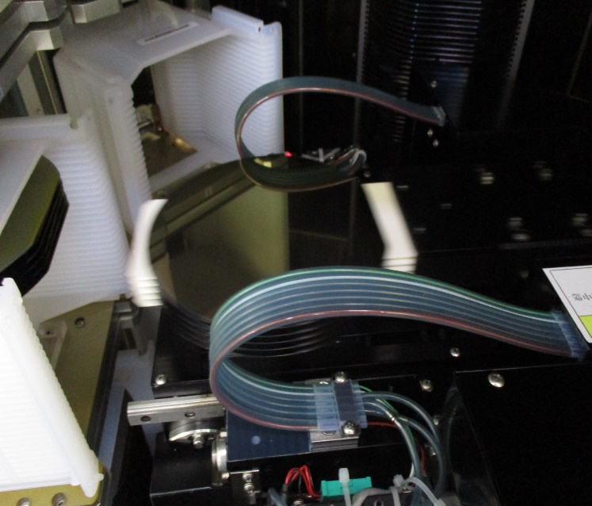
Step 26. Transfer check from Fork 5 to Fork 1.
Wafer Must be center.
NG
NG
Good
NG
NG
Remove the front cover of the machine.
Note: To check the gap of the wafer you have to open the back light and use mirror or go to the back of the machine to make it 100 % sure if not use flash light.
NG
NG
Fork 5 values.
C1 016 ,156
C2 046
C3 071
C4 096
C5 121
C6 146
Fork 1 values.
C8 21 B015 , B155
C1 B014, B154
C2 045
C3 070
C4 095
C5 120
C6 145
Make sure the wafer in every fork is on the center of the fork, do not allow the wafer to over lap to the fork.

Slide 11
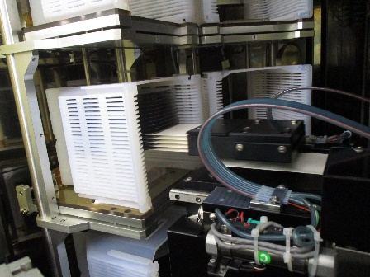

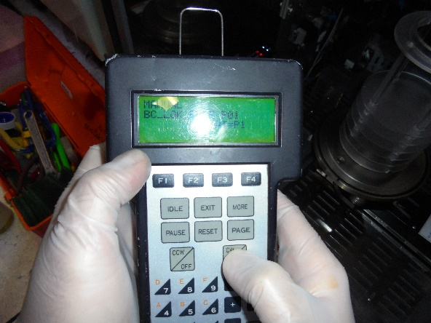
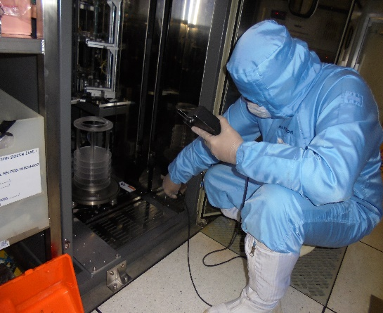
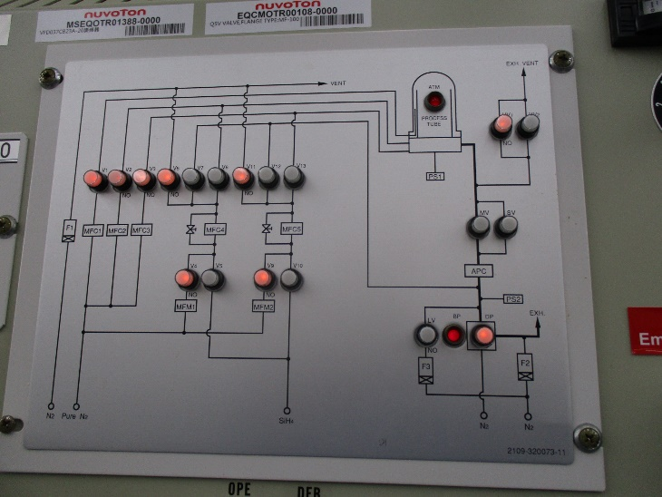
Step 27. Unload all the wafer back to the cassette.
Step 29. Boat UP. Use VL800 at the back for safety.
Watch it very carefully and your finger is ready to pause the process or abort for process abnormality.
Step 28. Unload all cassette.
Step 30. Leak check.
ON
To run leak check you must pump down by turn off all supply and turn on SV then wait till the base pressure is 5:00 Toor below and Open MV. Wait till base pressure is 0:00 Toor. If the base pressure is 0:00 Toor Close MV and SV wait till 70 sec. > 0:02 Toor considered to have a leak.
OFF

Slide 12
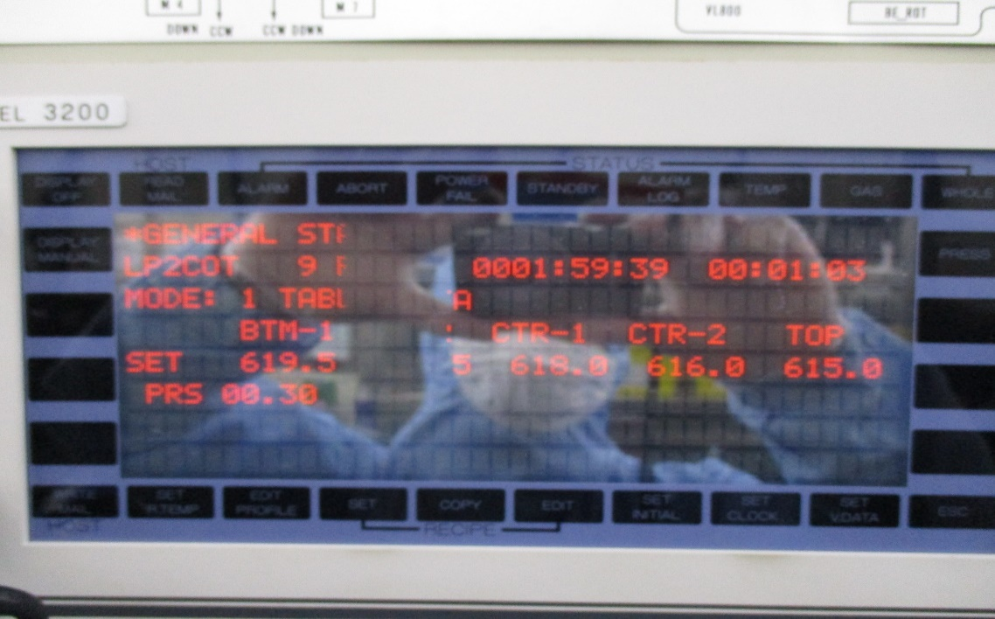
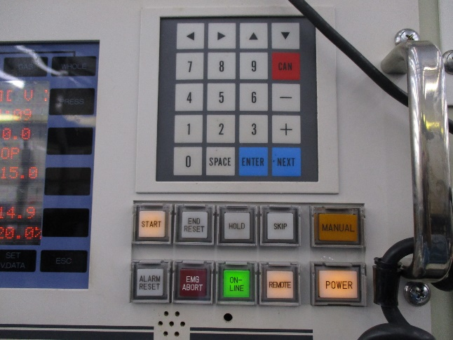
Step 31. Run manual purge for 1 hours.
ON
TEMP
To run manual purge open SV and if the pressure is below 5.0 Toor Open MV wait till 00.00 Toor set MF1, Mf2, Mf3 to get pressure of around 1 Toor
Whole
ESC
Step 32. Run Auto purge.
Steps to run auto coating.
Click set
Input password “ Space + 2 “.
Select LP(machine #)PG
Click ESC
Click Whole And confirm the recipe of Auto purge.
Click Temp. to check the temperature and double check the Auto purge recipe.
Click start if not check button if the remote is off.
Check VL800 if M01 to M06 is in P01 if all is in P01 Then click Start button.
SET
Light off to turn to auto.

Slide 13
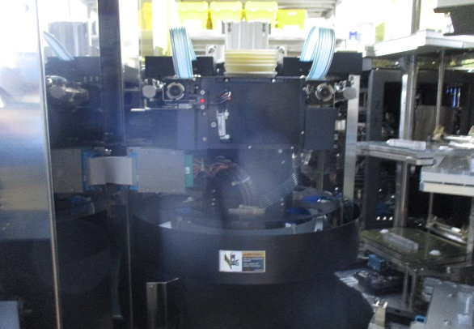
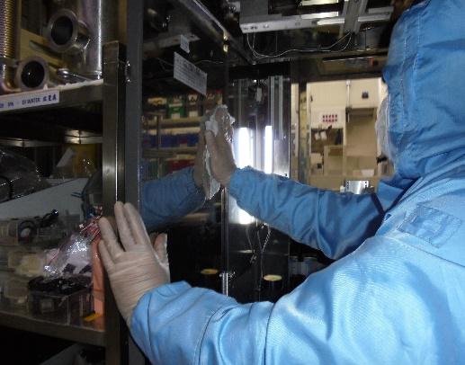
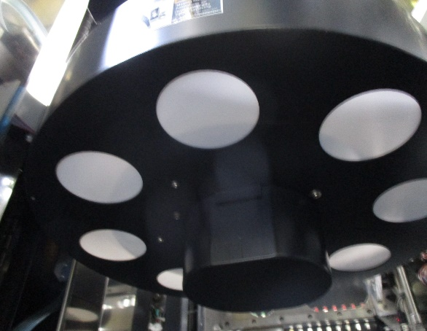
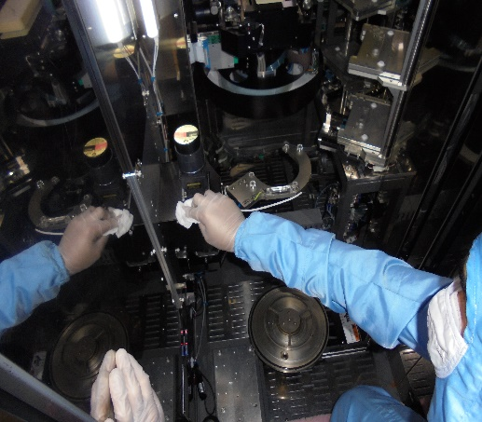
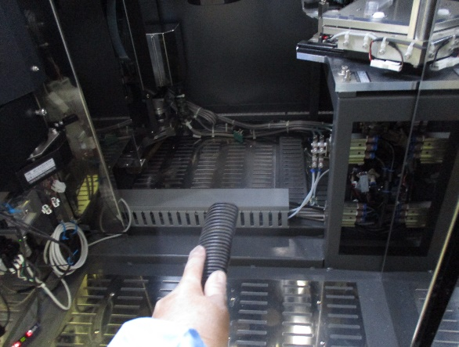
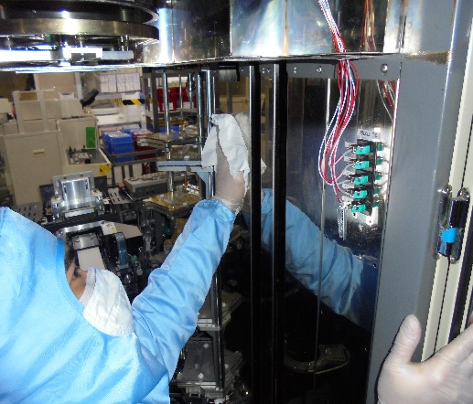
Step 19. If the boat is up already and the process of coating is starting clean machine.
Clean robot assembly.
Remove 3 screw and clean the cover.
Use vacuum, wiper and IPA.
After cleaning robot assemble use low vacuum to clean chamber and wipe it with IPA to make sure no particle..

